Slide 1

3.6 Fundamentals of cyber security
3.6.2 Methods to detect and prevent cyber security threats
Lesson

Slide 2
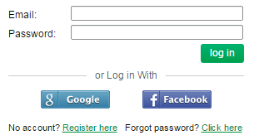
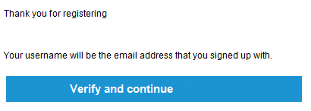
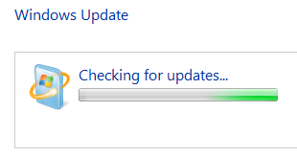
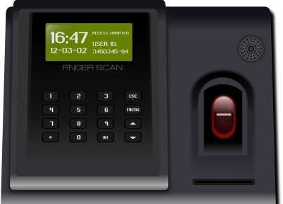
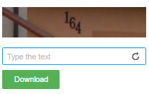
Starter activity
Look at the pictures and identify the security measures.
Email confirmations to confirm identity
Password systems
CAPTCHA
Biometrics
Automatic software updates
TIME UP
Start
Notes:
Click on ‘Start’ to begin the three-minute timer.

Slide 3

Starter activity: Answers
1
Biometrics
2
Email confirmations to confirm identity
5
CAPTCHA
4
3
Automatic software updates
Password systems

Slide 4
Discussion
Which of the security measures did you recognise?
What security measures have you used before?
When are these measures used?
How could cyber security threats be prevented or detected using these methods?

Slide 5
Objective
Understand and be able to explain security measures.

Slide 6
Security measures
Using email confirmations to confirm a user’s identity
CAPTCHA (or similar)
Password systems
Biometric measures (particularly for mobile devices)
Automatic software updates
Notes:
Biometrics: searchsecurity.techtarget.com/definition/biometrics
Biometrics is the measurement and statistical analysis of people's physical and behavioural characteristics. The technology is mainly used for identification and access control, or for identifying individuals that are under surveillance. The basic premise of biometric authentication is that everyone is unique and an individual can be identified by his or her intrinsic physical or behavioural traits. (The term "biometrics" is derived from the Greek words "bio" meaning life and "metric" meaning to measure.)
There are two main types of biometric identifiers:
Physiological characteristics: The shape or composition of the body.
Behavioural characteristics: The behaviour of a person.
Examples of physiological characteristics used for biometric authentication include fingerprints; DNA; face, hand, retina or ear features; and odour. Behavioural characteristics are related to the pattern of the behaviour of a person, such as typing rhythm, gait, gestures and voice.
Password systems
This could involve setting a string password, using passwords to access a system, document or restricted area. Password hierarchy is often used in companies and different people have different settings and access levels based upon their responsibilities.
en.wikipedia.org/wiki/Password **(Lots on this website about passwords)
A password is a word or string of characters used for user authentication to prove identity or access approval to gain access to a resource (example: an access code is a type of password), which should be kept secret from those not allowed access.
gov.uk/government/uploads/system/uploads/attachment_data/file/458857/Password_guidance_-_simplifying_your_approach.pdf – tips for an organisation using passwords
CAPTCHA: captcha.net
CAPTCHA: Telling Humans and Computers Apart Automatically
A CAPTCHA is a program that protects websites against bots by generating and grading tests that humans can pass but current computer programs cannot. For example, humans can read distorted text as the one shown below, but current computer programs can't:
The term CAPTCHA (for Completely Automated Public Turing Test To Tell Computers and Humans Apart) was coined in 2000 by Luis von Ahn, Manuel Blum, Nicholas Hopper and John Langford of Carnegie Mellon University.
Email confirmations for user identity
A link is sent to a user’s registered email address which they must open and click on in order to activate an account, e.g. for a shopping account with an online store.
Automatic software updates
Where a newer version of the software running on your device is available. This might be automatically updated/installed. The next version of the software is not normally automatically updated.
For example – A device currently runs software version 1. Update installs version 1.1. Next version available – software version 2 – but this is not automatically installed.

Slide 7
Security measures activity
You have been employed as the Cyber Security Advisor for a local business.
Create a user guide or infographic to help staff understand what security measures are and why they should use them to prevent cyber security threats.
Include images to support your explanations.
Notes:
This could be presented in a presentation/DTP document or using software that the student chooses. The next few slides have questions on as a guide if students need more direction/support.
Extra information
A video on security measure examples: youtube.com/watch?v=tS5_t_11eaU&spfreload=1
Extension task: theguardian.com/public-leaders-network/2015/oct/14/how-to-stop-cyber-attacks-on-your-organisation

Slide 8
Security measures activity
Examples of infographics:
media.cutimes.com/cutimes/article/2015/02/27/cut260704031504img001.jpg
gov.uk/government/publications/cyber-risk-management-a-board-level-responsibility/10-steps-summary
Notes:
For copyright reasons, we cannot include the infographics in the presentation. Please follow the links to see examples.

Slide 9
Security measures user guide – questions
What are biometric measures?
Why might they be used (particularly for mobile devices)?
How will biometric measures prevent cyber security threats?
Notes:
Further reading: iritech.com/blog/mobile-biometric/

Slide 10
Security measures user guide – questions
What are password systems?
Why might they be used?
Give an example of when they are used.
How will password systems prevent cyber security threats?
Notes:
Reading on how to create strong passwords: safeandsavvy.f-secure.com/2010/03/15/how-to-create-and-remember-strong-passwords/

Slide 11
Security measures user guide – questions
What is CAPTCHA (or similar)?
Give an example of when it is used.
Why is it used?
How does CAPTCHA prevent or detect cyber security threats?

Slide 12
Security measures user guide – questions
What is an email confirmation that confirms a user’s identity?
Why is it used? Give an example of when it is used.
How does the email confirmation prevent or detect cyber security threats?

Slide 13
Security measures user guide – questions
What are automatic software updates?
Why are they used? Give an example of when they are used.
How do automatic software updates prevent or detect cyber security threats?

Slide 14
Plenary – Draw quickly
In pairs:
Person A draws an image that represents one security measure.
Person B guesses which security measure they are drawing.
TIME UP
Start
Notes:
Click on ‘Start’ to begin the one-minute timer.

