Slide 1

3.3 Fundamentals of data representation
3.3.5 Character encoding and 3.3.6 Representing images
Lesson

Slide 2
Objectives – Character encoding
Understand how ASCII and Unicode are used to represent a range of printable text and characters.
Identify sequential patterns for the characters.
Match ASCII values to their characters.
Know how Unicode can be used for a wider range of characters.

Slide 3
Objectives – Representing images
Define the word ‘pixel’.
Explain how an image may be broken down using a grid to provide pixels with known coordinates.
Explain how various colour schemes may be digitally encoded.
Calculate the size of a digitally encoded image.
Notes:
Students may already know that ‘pixel’ is short for ‘Picture Element’. It is a single point in a graphical image.

Slide 4
How characters are represented using ASCII
This is how the letter N would be represented.
 | - | 2⁶ | 2⁵ | 2⁴ | 2³ | 2² | 2¹ | 2⁰
Maximum possible binary value using ASCII | - | 1 | 1 | 1 | 1 | 1 | 1 | 1 | = 127₁₀
 | - | 1 | 0 | 0 | 1 | 1 | 1 | 0 | = 78₁₀ = ‘N’
Minimum possible binary value using ASCII | - | 0 | 0 | 0 | 0 | 0 | 0 | 0 | = 0₁₀
This is the whole set of printable characters.
!"#$%&'()*+,./0123456789:;<=>?@
ABCDEFGHIJKLMNOPQRSTUVWXYZ[\]^_`
abcdefghijklmnopqrstuvwxyz{|}~
Look at the sheet of all the ASCII characters.
Notes:
7-bit ASCII (American Standard Code for Information Interchange) is a mechanism for encoding text that was developed over 50 years ago to standardise the transmission of characters using telegraph equipment. By modern standards, 7-bit ASCII is very limited but nonetheless has served as a useful standard for many years. It uses the first 7 bits of 8 in a byte for its scheme, limiting the possible range available from 0-127₁₀.

Slide 5
What character is represented by this 7-bit ASCII character code?
0 | 1 | 1 | 1 | 1 | 1 | 1 | 0
0 | 1 | 1 | 0 | 1 | 0 | 0 | 0
0 | 0 | 1 | 1 | 0 | 0 | 1 | 1
0 | 1 | 0 | 0 | 0 | 1 | 1 | 1
0 | 0 | 1 | 0 | 1 | 1 | 1 | 1
/
G
~
h
3
Notes:
Students should refer to their ASCII table for this activity.
Five questions – click for answers.
Demonstrate the sequential nature of the characters.

Slide 6
How characters are represented using Unicode
Unicode uses 16 bits to represent the character range.
Using 16 bits gives 2¹⁶ combinations or 65,536 possible binary patterns.
Unicode values are usually shown using hexadecimal.
Character | Ç | ɸ | Ш | ق | ∯
Hexadecimal value | 00C7 | 03D5 | 0428 | FED6 | 222F
Description | (Latin) Capital letter C with cedilla | (Greek) Phi Symbol | (Cyrillic) Capital Letter Sha | (Arabic) qāf | Mathematical surface integral symbol
The Unicode Standard covers (almost) all the characters, punctuations, and symbols in the world.
Notes:
As stated previously, ASCII represents a relatively limited range of characters. In order to represent the language requirements of everyone in the modern world, a character representation encoding scheme having a far greater range is required. Unicode is just that scheme and has been designed to cover all possible character sets in use with capacity to spare.
en.wikipedia.org/wiki/List_of_Unicode_characters is the Wikipedia page with the complete list.

Slide 7
Representing images
In order to represent images digitally, there are two areas that we need to look at:
resolution – the size of each pixel in the image (i.e. how many there are)
colour depth – how the colours of an image may be represented by digital encoding.

Slide 8

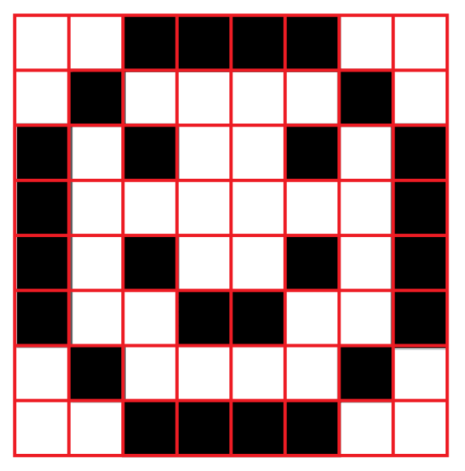
Representing images – looking at resolution
Pixel 0,0
Pixel 0,7
The original image
Pixel 7,0
Pixel 7,7
Overlaying the image with a grid.
Notes:
If we now overlay the original image with a grid we are able to take samples of the image in an ordered fashion. 8 x 8 grid required to capture full extent of detail. We refer to each visible cell as a pixel i.e. the smallest area of the image that can be represented digitally.

Slide 9
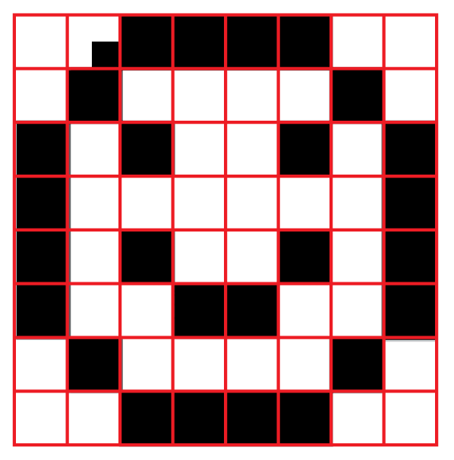
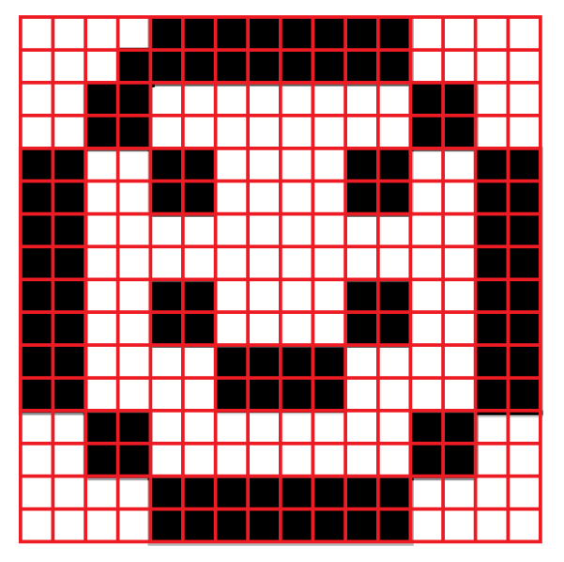
Representing images – looking at resolution
Element smaller than grid square
Pixel 0,0
Pixel 0,15
Increase scanning resolution
Look what happens if we add a smaller square to the original.
Pixel 15,0
Pixel 15,15
Overlaying the image with a 16 x 16 grid.
Notes:
Look however what happens if we add a smaller square to the original – the grid size is now insufficient to capture all of the detail required.
16 x 16 element grid required to capture full detail.

Slide 10
Representing images – transforming the image to a bitmap
Pixel 0,0
Pixel 0,7
Row number
Row 0 | 0 | 0 | 1 | 1 | 1 | 1 | 0 | 0
Row 1 | 0 | 1 | 0 | 0 | 0 | 0 | 1 | 0
Row 2 | 1 | 0 | 1 | 0 | 0 | 1 | 0 | 1
Row 3 | 1 | 0 | 0 | 0 | 0 | 0 | 0 | 1
Row 4 | 1 | 0 | 1 | 0 | 0 | 1 | 0 | 1
Row 5 | 1 | 0 | 0 | 1 | 1 | 0 | 0 | 1
Row 6 | 0 | 1 | 0 | 0 | 0 | 0 | 1 | 0
Row 7 | 0 | 0 | 1 | 1 | 1 | 1 | 0 | 0
Pixel 7,0
Pixel 7,7
We need to map the grid capture into a digital format
The simplest way is to map each square as on (1) or off (0). Each row can then be stored sequentially in an image file.

Slide 11
Representing images – transforming the image to a bitmap
How big would the first 8 x 8 image be?
We would need 64 bits to store the bitmap.
How big would the second 16 x 16 image be?
We would need 256 bits to store the bitmap.
Why does the second image need 256 bits?
Because the grid is 16 bits x 16 bits which makes 256b bits in total.

Slide 12

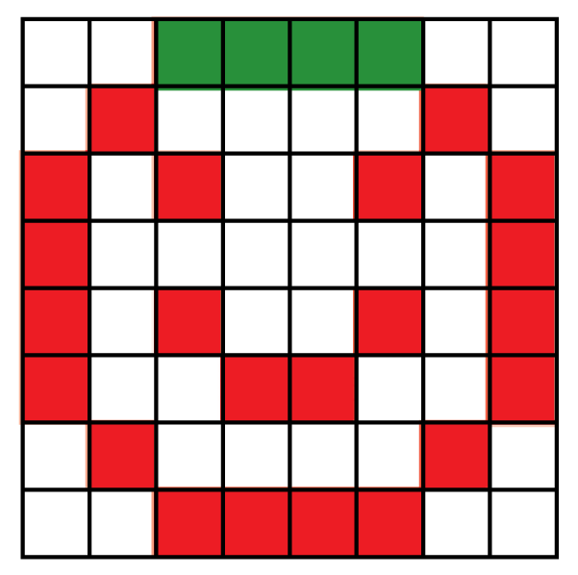
Representing images – looking at colour depth
Pixel 0,3 is green
The original image
Pixel 7,0 is white
Pixel 7,4 is red
Overlaying the image with a grid
Notes:
Now we have to consider that each cell may have a colour associated with it other than black or white.

Slide 13
Representing images – looking at colour depth
Cell location | Red intensity |  |  |  |  |  |  |  | Green intensity |  |  |  |  |  |  |  | Blue intensity
7,0 | 0 | 0 | 0 | 0 | 0 | 0 | 0 | 0 | 0 | 0 | 0 | 0 | 0 | 0 | 0 | 0 | 0 | 0 | 0 | 0 | 0 | 0 | 0 | 0
0,3 | 0 | 0 | 0 | 0 | 0 | 0 | 0 | 0 | 1 | 1 | 1 | 1 | 1 | 1 | 1 | 1 | 0 | 0 | 0 | 0 | 0 | 0 | 0 | 0
7,4 | 1 | 1 | 1 | 1 | 1 | 1 | 1 | 1 | 0 | 0 | 0 | 0 | 0 | 0 | 0 | 0 | 0 | 0 | 0 | 0 | 0 | 0 | 0 | 0
Notes:
Each cell can be mapped using 24 bits to describe the colour used.
Refer to Colour depth handout at this point.

Slide 14
Representing images – calculating bitmap file size
Image size in bits = W x H x D
= 8 x 8 x 24
= 1536 bits
Notes:
Resolution is Width (W) in pixels x Height (H) in pixels.
Colour Depth (D) is the number of bits needed to represent a single pixel’s colour.

