Slide 1

3.4 Computer systems
3.4.2 Boolean logic
Lesson 2

Slide 2
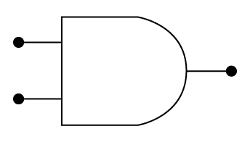

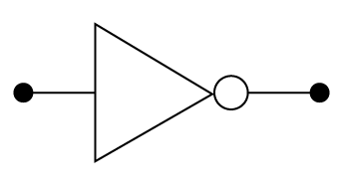
Starter activity
In groups of three, draw the symbols and corresponding truth tables for:
AND OR NOT
A
A
Q
Q
A
Q
B
B
AND
A | B | Q
0 | 0 | 0
0 | 1 | 0
1 | 0 | 0
1 | 1 | 1
OR
A | B | Q
0 | 0 | 0
0 | 1 | 1
1 | 0 | 1
1 | 1 | 1
NOT
A | Q
0 | 1
1 | 0

Slide 3
Objectives
Construct truth tables representing logic gate circuits.
Interpret truth tables.

Slide 4
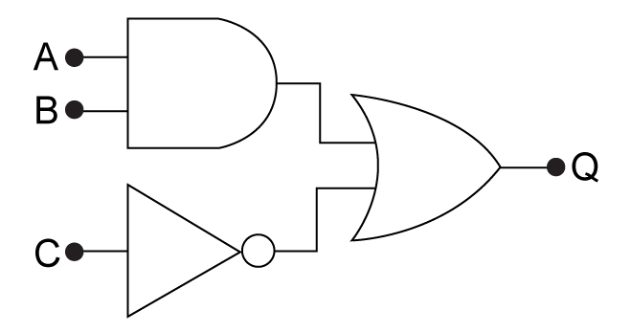
Combined gates - 1
 | How to construct a truth table for a more complex circuit
 | The circuit shows three gates in combination. Which is which? There are three inputs A, B and C and one final output Q.
Notes:
Ask the students – how many possible inputs can we have? (8 or 2^3)

Slide 5
Combined gates - 2
 | Truth table
 | Inputs |  |  |  | Outputs
 | A | B | C |  | Q
 | 0 | 0 | 0 |  | ?
 | 0 | 0 | 1 |  | ?
 | 0 | 1 | 0 |  | ?
 | 0 | 1 | 1 |  | ?
 | 1 | 0 | 0 |  | ?
 | 1 | 0 | 1 |  | ?
 | 1 | 1 | 0 |  | ?
 | 1 | 1 | 1 |  | ?
Click to reveal
Notes:
This is the truth table for a combination of an AND and a NOT gate. We can only see the inputs at the minute. Ask students if they can list the possible inputs.

Slide 6
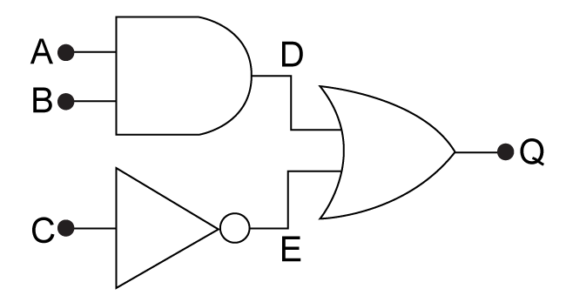
Combined gates - 3
 | Truth table
 | Inputs |  |  |  |  |  | Outputs
 | A | B | C | D | E |  | Q
 | 0 | 0 | 0 | 0 | 1 |  | ?
 | 0 | 0 | 1 | 0 | 0 |  | ?
 | 0 | 1 | 0 | 0 | 1 |  | ?
 | 0 | 1 | 1 | 0 | 0 |  | ?
 | 1 | 0 | 0 | 0 | 1 |  | ?
 | 1 | 0 | 1 | 0 | 0 |  | ?
 | 1 | 1 | 0 | 1 | 1 |  | ?
 | 1 | 1 | 1 | 1 | 0 |  | ?
Click to reveal
Click to reveal
Notes:
Look at the outputs immediately from the two gates when used normally. Remember, A AND B gives D and NOT C gives E.

Slide 7
Combined gates - 4
 | Truth table
 | Inputs |  |  |  |  |  | Outputs
 | A | B | C | D | E |  | Q
 | 0 | 0 | 0 | 0 | 1 |  | 1
 | 0 | 0 | 1 | 0 | 0 |  | 0
 | 0 | 1 | 0 | 0 | 1 |  | 1
 | 0 | 1 | 1 | 0 | 0 |  | 0
 | 1 | 0 | 0 | 0 | 1 |  | 1
 | 1 | 0 | 1 | 0 | 0 |  | 0
 | 1 | 1 | 0 | 1 | 1 |  | 1
 | 1 | 1 | 1 | 1 | 0 |  | 1
Notes:
D OR E gives Q. There are five combinations of inputs that lead to TRUE (1) and three that output FALSE (0). Even with this simple example, the tables become quite hard to follow very quickly!

Slide 8
Consolidate your learning
Try the Quiz and once your answers have been checked then work with a partner to:
Create a logic circuit diagram with two inputs and construct the truth table for it.
Create a logic circuit diagram with three inputs and construct the truth table for it.
Use A3 paper so your results can be shared with the class.

