Slide 1

3.4 Computer systems
3.4.2 Boolean logic
Lesson 1

Slide 2
Objectives
Know what is inside a CPU.
Understand what the NOT, AND, OR logic gates do.
Construct truth tables for NOT, AND, OR gates.

Slide 3
Hardware and software
Computers are composed of hardware and software.
Let’s make sure that we understand what these two terms mean.
Term: | Definition:
Computer hardware | Physical components, including electrical circuits, that a computer is assembled from.
Computer software | A sequence of instructions that is understood and executed by computer hardware.
computerhope.com/issues/ch000039.htm

Slide 4
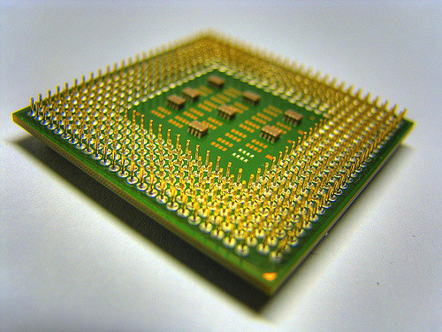
The CPU
Can you identify the parts on this CPU?
Notes:
© Jiahui Huang 2009 https://flic.kr/p/5QZB7Y (Shared under a CC BY-SA 2.0 licence: https://creativecommons.org/licenses/by-sa/2.0/)

Slide 5
What is in the CPU?
A very large number of electric circuits which are referred to as integrated circuits.
The circuits form the basis of logic gates.
The arrangements of these logic gates allow us to program the CPU.
youtube.com/watch?v=NKYgZH7SBjk
It is the nature of these logic gates that we are interested in and the use of Boolean logic allows us to characterise their behaviour.

Slide 6
What is Boolean logic?
Boolean logic describes the states of the inputs to and output from the logic gates.
Boolean logic represents all values as TRUE (1) or FALSE (0).

Slide 7
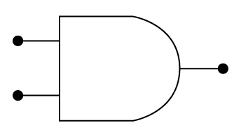
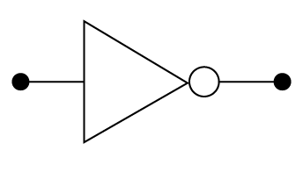
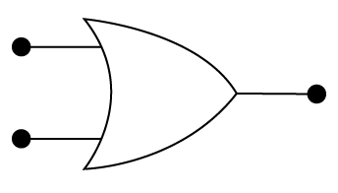
The logic gates we need to know for GCSE
Gate type | Symbol
AND gate
NOT gate
OR gate

Slide 8
How do logic gates work?
bbc.co.uk/education/guides/zc4bb9q/revision/2
Notes:
Watch first 50 seconds for AND, NOT, OR. (XOR is mentioned from 50 seconds to end.)

Slide 9
AND gate truth table
Each logic gate has a truth table.
It shows the inputs and output that characterise the logic gate.
youtube.com/watch?v=ksBqkJSq1QE
Fill in the AND gate truth table on your sheet.
AND gate | Truth table
 | Inputs |  | Output
 | A | B | Q
 | 0 | 0 | 0
 | 0 | 1 | 0
 | 1 | 0 | 0
 | 1 | 1 | 1
A
Q
B
Notes:
Watch until 2:47 for animation of AND gate and the truth table. https://www.youtube.com/watch?v=ksBqkJSq1QE

Slide 10
OR gate truth table
Fill in the OR gate truth table on your sheet.
OR gate | Truth table
 | Inputs |  | Output
 | A | B | Q
 | 0 | 0 | 0
 | 0 | 1 | 1
 | 1 | 0 | 1
 | 1 | 1 | 1
A
Q
B
Notice how many TRUE outputs there are compared to the AND gate.

Slide 11
NOT gate truth table
Fill in the NOT gate truth table on your sheet.
OR gate | Truth table
 | Input | Output
 | A | Q
 | 0 | 1
 | 1 | 0
A
Q
This time there is only one input and the output is always the opposite value. We call this ‘inverting’ the input. The output is always ‘NOT’ the input!

Slide 12
Summarise what we’ve learnt
Try Quiz

